Slide 1
Predicting Heart Disease Risk
Bilal Kudaimi
Notes:
This project centers around constructing a binary classification model that was built to predict which hospital patients will develop heart disease.

Slide 2
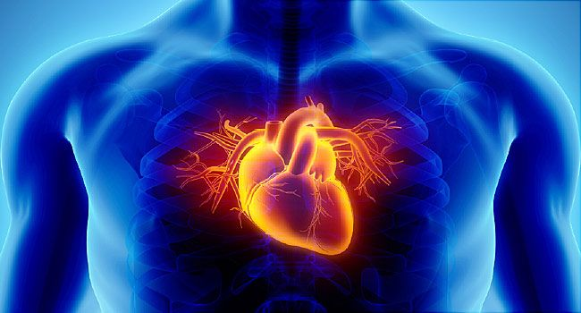
Introduction/Problem
Heart disease claims 659,000 lives and $363B annually
  Can it be identified before its onset?
Notes:
Heart disease kills many people in the U.S. each year and is responsible for billions of dollars in diagnosis and treatment costs. The billions that hospitals spend on blood tests and EKGs to identify heart disease alone could better be spent treating the disease. Is there a way to use a patient’s health information to identify their risk of heart disease?

Slide 3
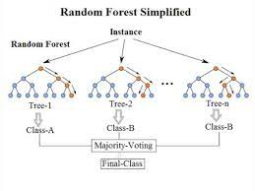
Solution
Patient info can accurately predict heart disease
A machine learning model will be used
  Random forest classifier
Notes:
There is such a way! Fortunately, there are many key health factors that increase the risk of heart disease. With a dataset of patients and whether they have those factors, a machine learning model can be trained on dataset to predict who will develop heart disease in the next 5 years. This would allow hospitals to better focus their resources, saving lives and reducing diagnosis costs. Random forest classification will be used for the model as it works well on large datasets with a binary target variable.

Slide 4
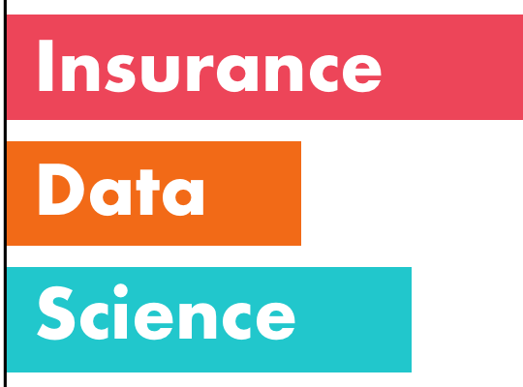
Ethical Considerations
One of the first things considered
Insurance may abuse the model
Notes:
This was one of the first things I considered after understanding the business problem and the data. Would this model have any ethical implications? In the future, insurance companies may abuse the model described in this project to raise the premiums on patients predicted to develop heart disease.

Slide 5
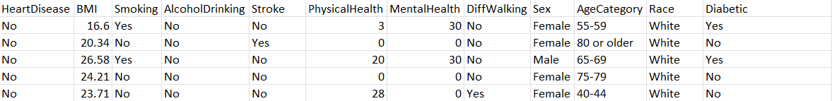
Dataset
Notes:
Here’s a snippet of the dataset used to train and test the model (data obtained from the Behavioral Risk Factor Surveillance System (BRFSS). Each row is one patient at a hospital and each column represents one health feature of that patient identified as a heart disease risk factor, such as BMI, smoking, age, exercise, etc. To save space, not all features are shown above.

Slide 6
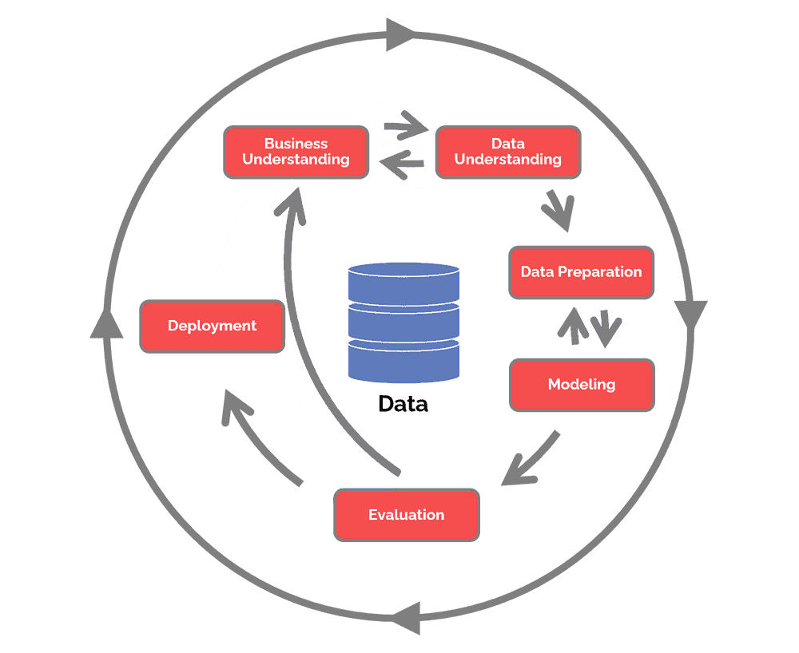
Procedure for Analysis
Three steps need to be done:
  Data preparation
  Exploratory data analysis
  Model training/testing
Notes:
The procedure for constructing the model involves three steps: Preparing or “cleaning” the data, running some EDA to gain insight into the data, then training and testing the model. Accuracy and precision, both out of 100, were used to measure how well the model performed.

Slide 7
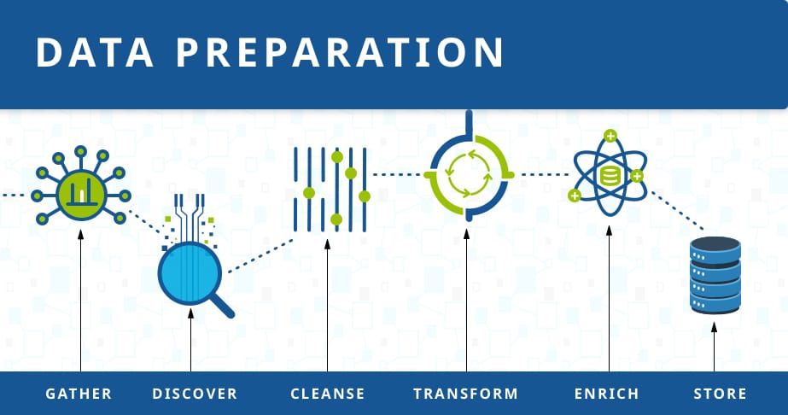
Part 1: Data Preparation
Organizing or “cleaning” the data
  Checking for N/A values
  Replacing strings with integers
  Oversampling
Notes:
Data “cleaning” was done to prepare the data for input into the model. First, each feature was checked for NA values and non-numerical columns. No NA values were found, and any Boolean/multiclass columns had their strings replaced with integers (e.g., a five-category column received 0-4 as integers). Finally, because very few patients in the dataset had heart disease, those patients were oversampled to make the number of patients with and without heart disease equal.

Slide 8
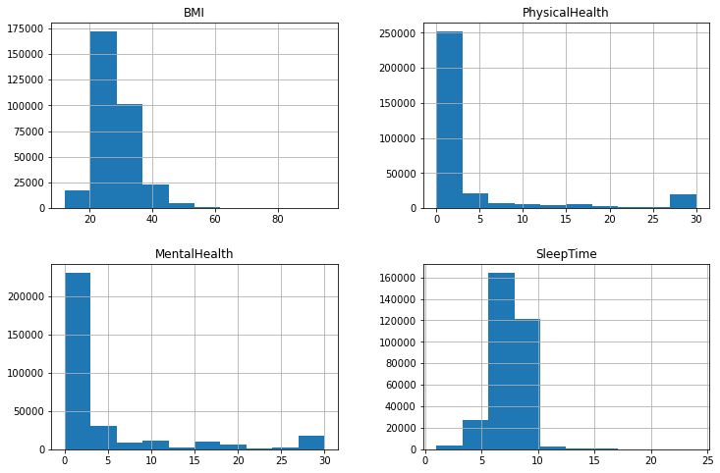
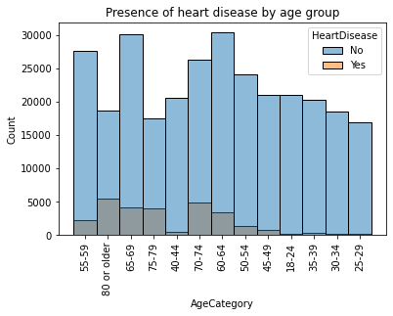
Part 2: EDA
Notes:
The EDA step was conducted to gain insight into the data and ballpark the range that the accuracy and precision might fall under. Here are selected graphs that were part of the EDA process.

Slide 9
Part 3: Model Training/Testing
Random forest classifier (20% data used for testing)
 | Accuracy | Precision
Random Forest Classifier | 96.9% | 94.2%
Notes:
After training and testing the model, the following values for the error were output. Since the model was a classifier, accuracy and precision were used to see how well it performed. Both values were above 90%, indicating the model performed very accurately. Conclusion: The model can be implemented!

Slide 10

Assumptions
A few assumptions were made to proceed:
  Heart disease is one disease
  BRFSS answered correctly
Notes:
A few assumptions were made to proceed with this project. First and foremost, it was assumed that heart disease is one disease rather than related diseases under the same umbrella term. Second, it was assumed that the patients answered the BRFSS truthfully and the dataset obtained is accurate.

Slide 11

Challenges Encountered
This model wasn’t without its challenges
  Many models cycled before random forest
  Power limitations
Notes:
This model wasn’t without its challenges. Many models were cycled through before random forest:
Logistic regression was the first logical choice for binary classification since it also handles large datasets, but it quickly proved to be undesirable, producing accuracy and precision scores of 72% and 73%, respectively. Medical models must be very accurate as patients’ lives can be drastically affected by a false positive/negative.
A Keras neural network was trained and tested next, which produced higher scores, but the network took many hours to run even after tuning hyperparameters.
A random forest classifier was then selected. This classifier resulted in the high scores seen above, though its runtime still leaves something to be desired.
More computing power will be needed to solve this problem for future uses on actual hospital data.

Slide 12


Future Model Uses
The model has a few other uses in the future:
Notes:
The model isn’t limited to heart disease predictions. With training on a different dataset, a similar model could be applied to predicting whether a customer will buy a class of products. Most notably, it can be applied to cell phone providers to predict which customers will stay or leave within a certain time.

Slide 13
Q&A
When testing the different models, were there any others that could be tested?
On a larger data scale, is there enough computing power for hospital data?
Are there other ways of optimizing runtimes besides more computing power?
If heart disease is multiple diseases, could the model predict which disease a patient would develop in addition to a Yes/No answer?
The diseases that make up the heart disease umbrella are mentioned to have “similar risk factors” but are they similar enough that one model can predict all?
Will this model work for predicting other diseases with similar risk factors?
Would hyperparameter tuning have affected the values of the scoring metrics?
What other future uses are there for this model besides for cell phone providers?
Why was over-sampling chosen over under-sampling to balance the classes?
How can insurance companies be prevented from abusing this model?
Notes:
1. Yes. Boosting algorithms could have been tested as well, but there was not enough time.
2. There should be enough computing power if each hospital possesses its own server.
3. Yes. A random sample of the data can be used rather than the whole data, as long as it’s sufficiently large for training.
4. The dataset would need another column specifying which disease the patient has if there is a “Yes” on heart disease.
5. Most of these diseases have similar enough risk factors that the model could predict whether a patient has one, but a separate column would still be needed to specify.
6. This model doesn’t work for other diseases, even if they have similar risks.
7. Hyperparameter tuning for each model did not yield greater than a 0.5% increase in accuracy.
8. One could also use this model in predicting other disease risks given the right dataset.
9. Oversampling and undersampling both balance the target variable, but oversampling increases the sample size.
10. There are several ways, but one way could be to use regulations and audit the companies.

Slide 14
References
Allen, M. (2018). Health Insurers and Vacuuming Up Details About You – And It Could Raise Your Rates. ProPublica. Retrieved on April 30, 2022 from https://www.propublica.org/article/health-insurers-are-vacuuming-up-details-about-you-and-it-could-raise-your-rates.
Beckerman, J. (2021). Heart Disease: Types, Causes, and Symptoms. WebMD. Retrieved on April 30, 2022 from https://www.webmd.com/heart-disease/heart-disease-types-causes-symptoms.
Karabiber, F. (2022). Binary Classification. LearnDataSci. Retrieved on April 30, 2022 from https://www.learndatasci.com/glossary/binary-classification/.
Koehrsen, W. (2018). Hyperparameter Tuning the Random Forest in Python. Towards Data Science. Retrieved on April 30, 2022 from https://towardsdatascience.com/hyperparameter-tuning-the-random-forest-in-python-using-scikit-learn-28d2aa77dd74.

